Slide 1
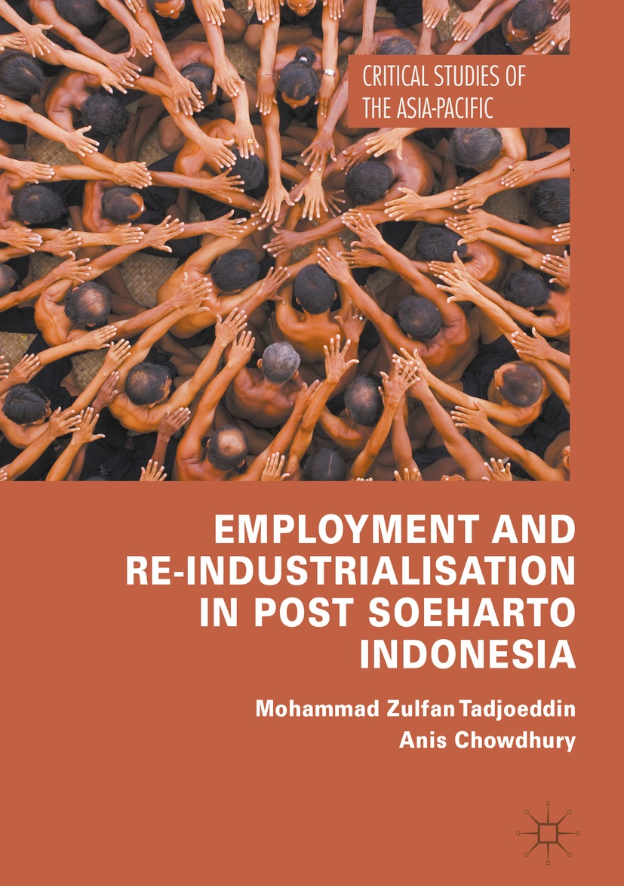

Book Launch & Seminar
Jakarta 25 July 2018
SMERU Research Institute

Slide 2

Employment and re-industrialisation in post Soeharto Indonesia
Dr Zulfan Tadjoeddin
z.tadjoeddin@westernsydney.edu.au
Professor Anis Chowdhury
a.chowdhury@westernsydney.edu.au

Slide 3
Outlines
Book chapters – overviews
Key policy massages

Slide 4
Seven Chapters
Introduction
An overview of employment situation
Earnings, productivity and inequality
Wages, employment, productivity in the manufacturing sector
Determinants of employment, wage and productivity
Inequality, employment and manufacturing: Spatial dimensions
Policy perspectives

Slide 5
Ch 1: Introduction

Slide 6

Background
Pre AFC (1970-1997):
  Manufacturing growth exceeded overall economic growth
  The share of manufacturing rose from around 10% to close to 30%
  Stable inequality
Post AFC:
  Manufacturing growth fell below overall growth
  Premature de-industrialisation
  Manufacturing jobless growth
  Disjoint between real wage and productivity growth
  Rising inequality

Slide 7
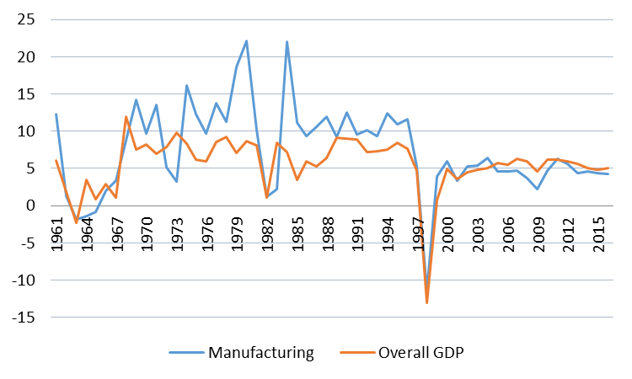
Slowing manufacturing growth - deindustrialisation
Manufacturing’s share in GDP fell from 30% in 2001 to around 25% in 2014.
Manufacturing’s share in exports fell from 57% in 2001 to 40% in 2014.

Slide 8
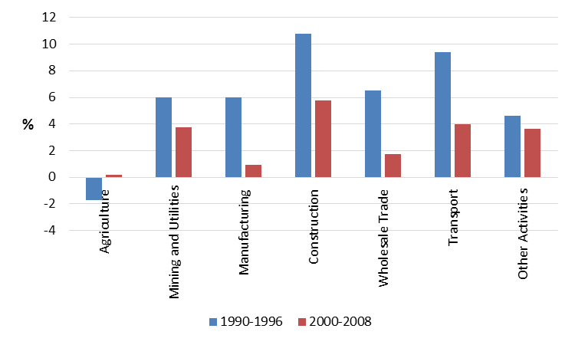
Post-AFC: decline in employment growth & stagnant structural changes

Slide 9
Post-crisis decline in output-employment elasticity – jobless growth in key sectors

Slide 10
Ch 2: An overview of employment situation

Slide 11
From quantity to quality
Employment quantity
  Unemployment rate
Employment QUALITY
  Formal employment (decent jobs)
  Under employment
  Real wages/earnings
  Incidence of low pay/ wage inequality

Slide 12
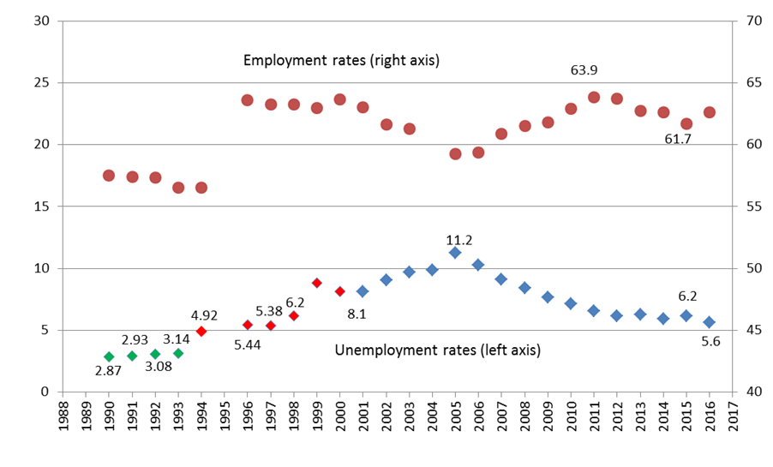
Employment and unemployment rate (%), 1990-2016

Slide 13
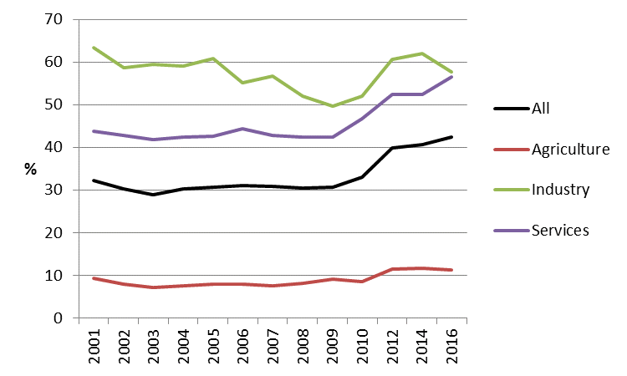
Regular employment by sector, 2001-2016
(% of total employment)

Slide 14
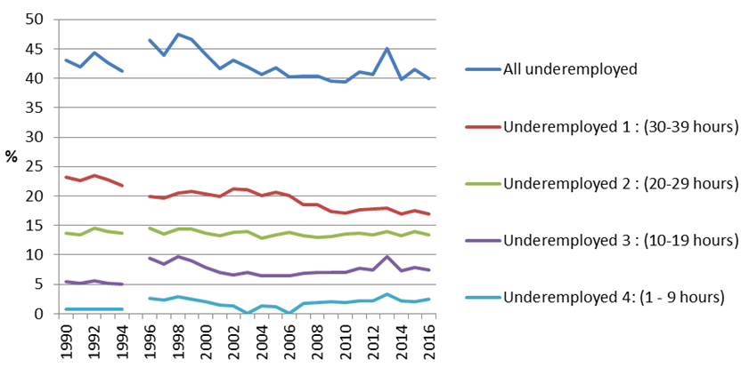
Under-employment 1990-2016
(age 15-59, as % of total employment)

Slide 15
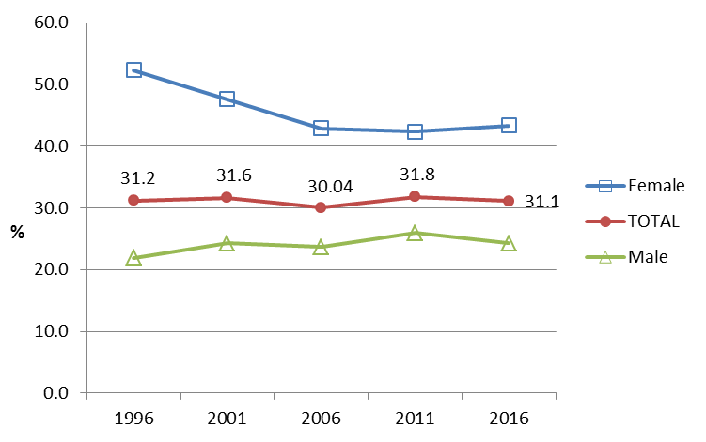
Low pay incidence

Slide 16
Ch 3: Earnings, productivity and inequality

Slide 17
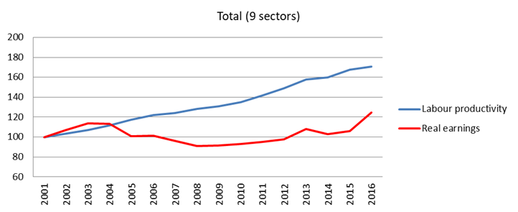
Labour productivity and real earnings, 2001-2016 (2001=100)

Slide 18
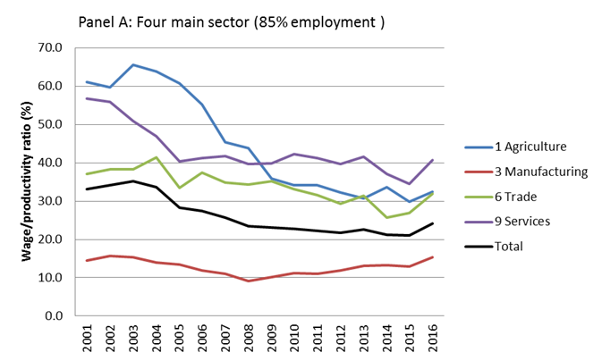
Wage earnings lagging behind productivity 2001-2016

Slide 19
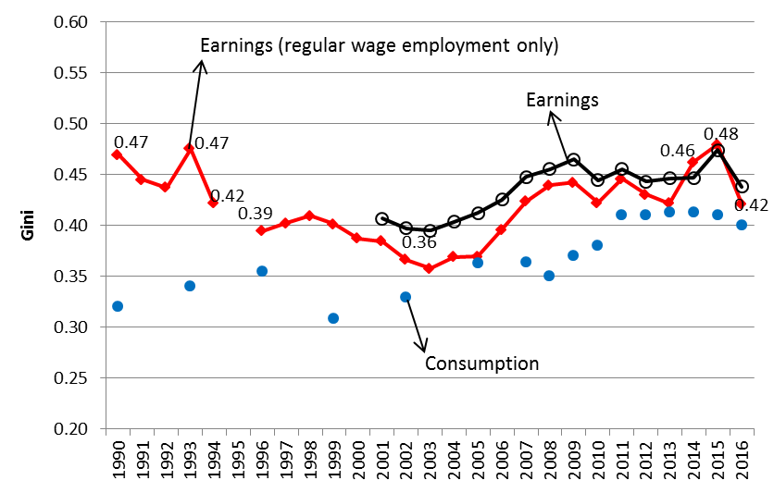
Gini index of earnings and consumption expenditure, 1990-2016

Slide 20
Ch 4: Wages, employment, productivity in the manufacturing sector

Slide 21
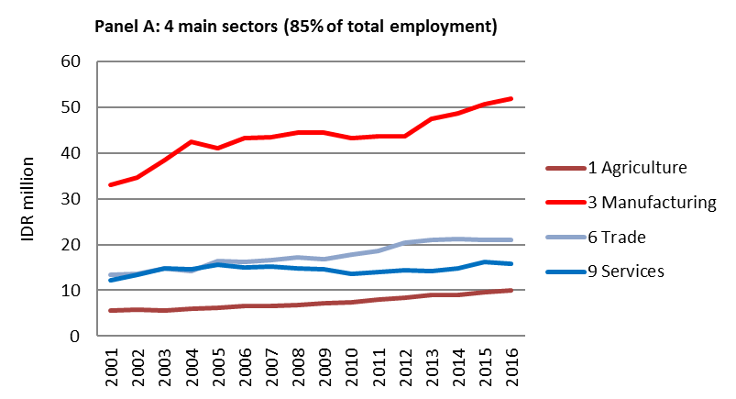
Productivity trend

Slide 22
Productivity trend Wage-productivity ratio

Slide 23
Ch 5: Determinants of employment, wage and productivity

Slide 24
Key findings
Productivity is the most important determinant of real wage (manufacturing); next is capital intensity.
  No significant effect of export orientation and foreign ownership on productivity
Productivity, wages and employment move together
This ideal scenario found in the large-medium manufacturing sector

Slide 25
Ch 6: Inequality, employment and manufacturing: Spatial dimensions

Slide 26
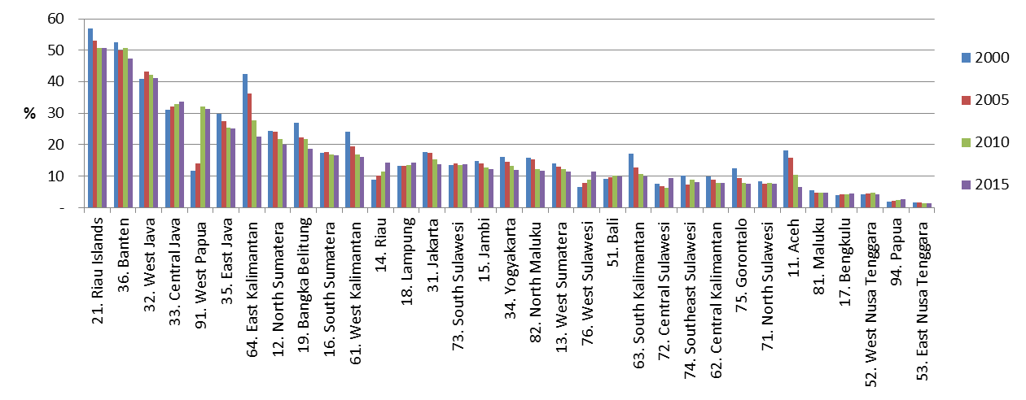
Shares of manufacturing in provincial RGDP

Slide 27
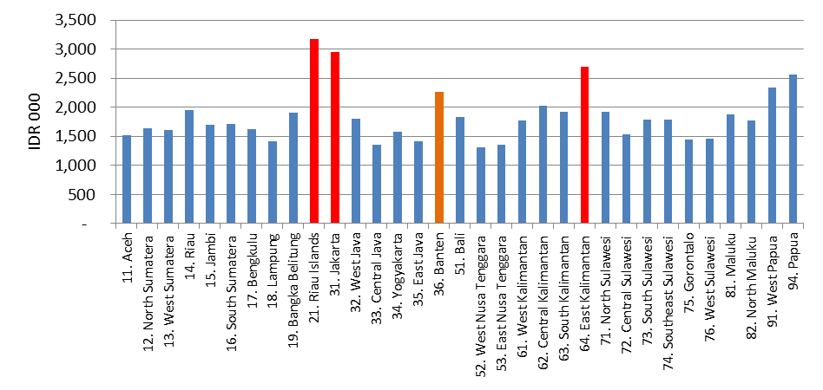
Wage-earning across provinces, 2015 (IDR 000/month)

Slide 28
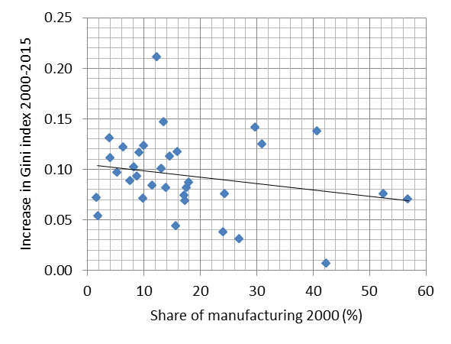
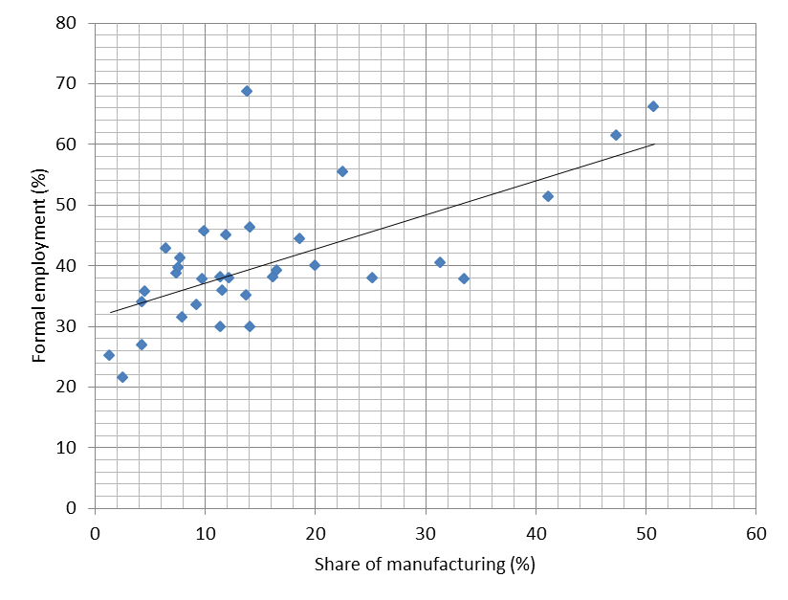
Manufacturing is the key
MNF slows inequality
MNF improves emp. quality

Slide 29
Ch 7: Policy perspectives

Slide 30
THREE inter-related challenges
Premature de-industrialisation
Stalled structural changes – persistence of informality
Rising inequality
Different context
Democratic polity
Decentralised governance
Uncertain global economy

Slide 31
Diversity for internal dynamism
The diversity of Indonesia’s regions in terms of stages of socio-economic development and resource endowments is an asset as they should complement each other in creating internal dynamism to expand domestic market and flexibility to compete internationally.
Diversity in regional minimum wages is critical in facilitating industrial relocation in line with regional comparative advantage.
Strong forward and backward linkage (across sectors and between regions)

Slide 32

Minimum wage policies
Variation across provinces (potential for internal flying geese)
Low compliance
Wage-earnings inequality declines with the increase in the minimum wage compliance rate, as this improves labour’s bargaining power.

Slide 33
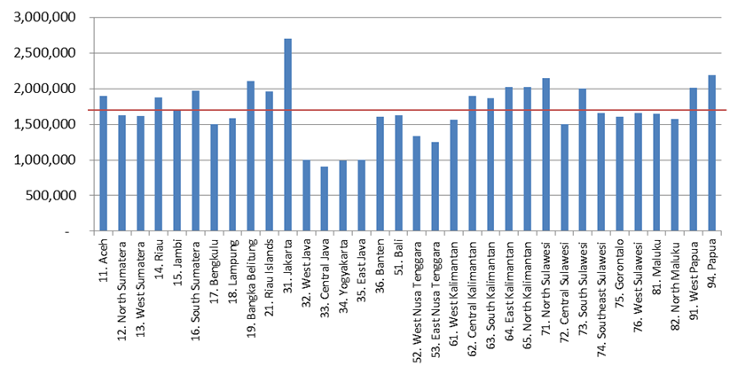
Provincial minimum wage (IDR per month), 2015

Slide 34
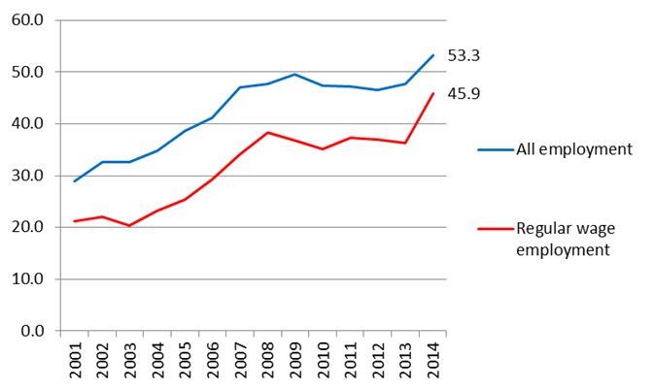
Percentage of workers earning less than provincial minimum wages

Slide 35
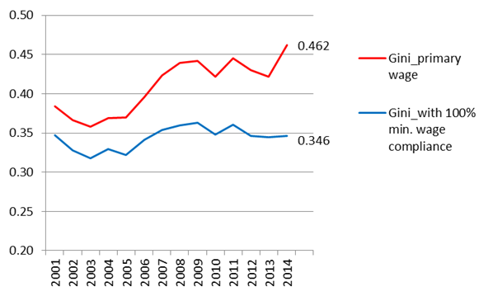
Minimum wage compliance and inequality

Slide 36
Key policy messages
The policy framework to achieve “pekerjaan dan penghidupan yang layak bagi kemanusiaan” (article 27, UUD 1945), should emphasise improving employment quality instead of quantity.
Minimum wage policies can play a useful role in addressing the rising inequality trend by reversing the widening gap between productivity and wage-earnings, in turn tackle inequality
The dynamic and modern manufacturing sector, represented by the large and medium establishments, provides an ideal platform for enhancing formal employment and re-aligning productivity and wages.
The diversity of Indonesia’s regions in terms of stages of socio-economic development and resource endowments is an asset as they should complement each other in creating internal dynamism to expand domestic market and flexibility to compete internationally.

Slide 37
Thank-you

