Slide 1

Understanding Multidimensional Child Poverty and Disparity: Voices of Children
Ir. Widjajanti Isdijoso, M.Ec.St

Slide 2
Children are more likely to live in poverty than adults and are also more vulnerable to its effects.
- UNICEF
Notes:
Yet, child poverty is mostly viewed from the perspective of adults. Children’s aspirations have not been sufficiently accommodated by the policy makers. Hence the child-related intervention programs by the governments are biased to adults’ perspective and may not fulfill children’s actual needs.

Slide 3
Two Studies on Child Poverty
The 2013 Update of Multidimensional Child Poverty in Indonesia
  Quantitative analysis using Susenas 2013 dataset on multidimensional poverty and deprivation
Urban Child Poverty and Disparity: The Unheard Voices of Children living in Poverty
  Qualitative analysis on the perspective of the children who live in slums areas in Jakarta, Makassar and Surakarta
Notes:
In this presentation, the findings of our studies with UNICEF that discuss the multidimensional child poverty and children’s views on the poverty issues will be shared
Despite the studies were conducted seven years ago, it is believed that the condition does not change that much, and it could even get worse due to the impact of pandemic Covid-19

Slide 4
The 2013 Update of Multidimensional Child Poverty
1

Slide 5
Multidimensional Child Poverty and Deprivation
The Multiple Overlapping Deprivation Analysis
Children’s life-cycle approach
(i) infancy (0–1 year), (ii) 2–4 years, (iii) 5–11 years, (iv) 12–14 years, (v) 15–17 years.
Notes:
We employed The Multiple Overlapping Deprivation Analysis (MODA) developed by UNICEF for the analysis. It has some advantages compared to other methods. First, it uses children, rather than households, as the analysis unit. This allows us to obtain deeper information on the living condition of children.
Second, this method uses children’s life-cycle approach, which means that it distinguishes between the needs of children at different age levels. Compared to other multidimensional measurement tools, this approach can accommodate the variation of basic needs across age groups in measuring
children’s well-being. In this study, children are grouped into five categories: (i) infancy (0–1 year), (ii) 2–4 years, (iii) 5–11 years, (iv) 12–14 years, (v) 15–17 years.
In this study, we also use twice the official poverty line (2PPL) to calculate the vulnerable children. Children who live below the PPL will be defined as poor children, while those who are just above the official poverty threshold but still below the 2PPL are defined as vulnerable. Wealthy group consists of children who live above the 2PPL

Slide 6
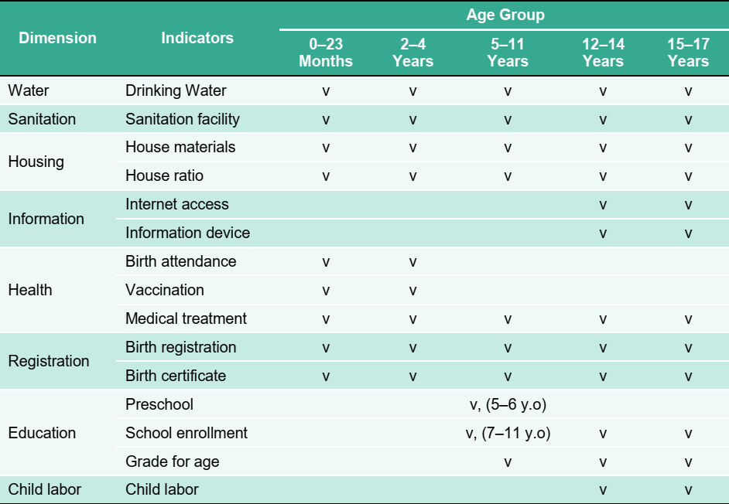
Dimensions and Indicators by Age Group
Notes:
Indicators and dimensions constructed in this study are based on the Convention on the Rights of the Child (CRC). There are eight dimensions of children’s life used in this analysis. Some dimensions, such as water, sanitation, and housing are applied to all age groups. While, some other dimensions are only relevant to specific age groups, such as child labor and information.

Slide 7
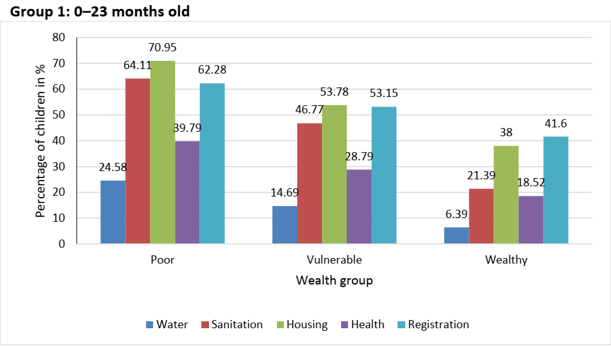
Infancy’s Deprivation Across Wealth Groups
Notes:
Poor children are indeed the ones who are most likely to experience deprivation in one or more dimensions of life. Yet, better financial condition does not guarantee non-poor children to be free from any deprivation.
Overall, Infants from a more resourceful household have the lowest deprivation rates compare to the other two groups. Nonetheless, we can see that there are significant proportion of children in this group who are still deprived in the dimensions of housing and registration

Slide 8
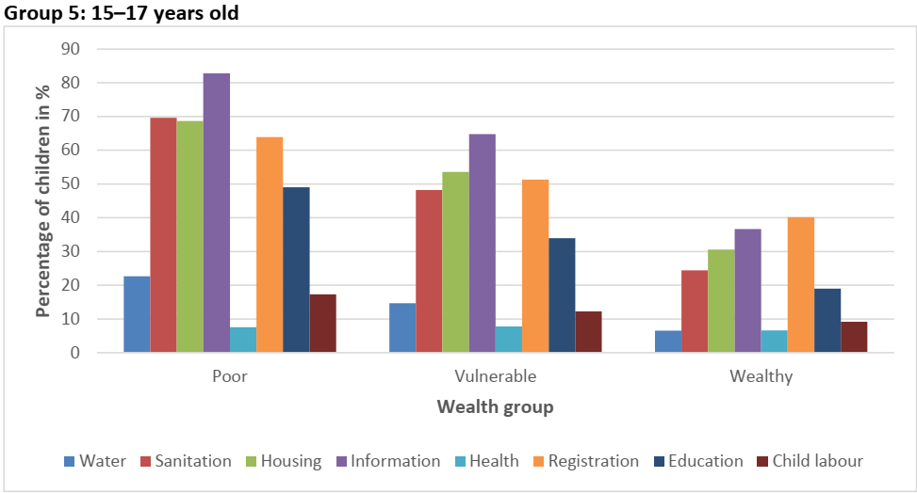
Youth’s Deprivation Across Wealth Groups
Notes:
The second example of deprivation analysis is taken from the eldest age group (15-17 years old)
Despite a better financial condition enjoyed by youths in the wealthy group, around 40% of children in this group are not registered or do not have birth certificate. Being deprived in this dimension could lead to the difficulties to access various services and benefits for the children.

Slide 9
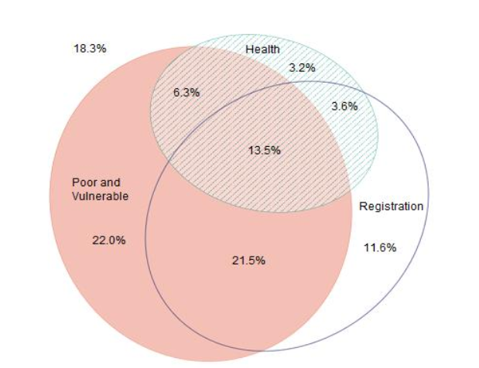
Infancy’s Overlapping Deprivation Analysis
Notes:
In conducting overlapping deprivation analysis for the infancy group, we selected health and registration dimensions because these dimensions are critical for children in this age group. Lack of access to health services such as vaccination and medical treatment may have a long-term impact on the infants’ future development. Moreover, being deprived in registration can also prevent the infants to access some benefits and facilities that are important for their development.
There is 13.5% children who are poor and vulnerable, yet at the same time also deprived in health and birth registration dimensions. These children are in the worst condition compared to other children in this group because they suffer from both monetary poverty and dimension deprivation simultaneously.
From this venn diagram, we see that there are still fractions of children who are not poor or vulnerable but remain deprived in either one or both dimensions. This
implies that monetary poverty is not the solely reason behind child’s deprivation in health and birth registration.

Slide 10
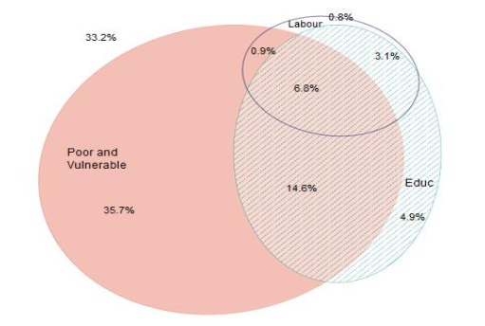
Youth’s Overlapping Deprivation Analysis
Notes:
For children aged 15–17 years, education and child labor dimensions are chosen to examine the overlap rate between non-monetary dimension and monetary poverty deprivation. These dimensions are selected because children from this age group are vulnerable to drop out of school and enter the labor force.
Around 6.8% of all children aged 15–17 years who are poor and vulnerable, lack behind on their education and at the same time becomes a child labor. The deprivation rate for children who live in poverty and deprive in their schooling is stood at 14.6% which relatively high compared to the other combinations with two dimensions. Monetary poverty appears to have the highest deprivation rate, and is explaining high proportion of deprivation in education and working dimensions

Slide 11
The Unheard Voices of Children living in Urban Poverty
2

Slide 12
Analytical Framework
The Ecological Framework of a Child’s Development
A Subjective Approach of Poverty and Well-Being
Notes:
This study uses the development theory developed by Bronfenbrenner. Known as ecological framework, it recognizes children’s and parents’ perception and interpretation on their experiences with their surroundings, such as family, peers and neighbour in determining the influences of local environment on a child’s development.
This study emphasizes the use of subjective perspective of children in understanding poverty, including what constitutes poverty, and the problems around it, as well as what is needed to move out of poverty and those problems.

Slide 13


Children’s Perspective on Poverty
Poverty affects both the material and nonmaterial aspects of a child’s life
Children do not perceive themselves as poor
Notes:
Children at a younger age tend to focus on material aspects, while older children have more exposure to the social environment and start to recognize social status.
even though there are a few children who admit they are poor, they tend to identify themselves with other terms, such as average group, which in the Indonesian context is understood to be slightly different from the “poor” group. This might tell us a few things about how children feel about living in poverty. It could be an expression of denial since being the poorest members of a community can be a shameful experience.
These findings may bring us to a further conclusion; the fact that children do not identify themselves in the poorest group and prefer to use other terms than ‘poor’, highlights an undesirable image attached to the ‘poor’ label. Therefore, programs aiming to reach poor children in this country may consider how the use of the ‘poor’ label may bring undesirable influences on children.

Slide 14
Children’s Perspective on Housing and Living Environment
1
Unclean environment
2
Poor housing
3
Lack of water supply and public toilet
4
Lack of playground
Notes:
Children raise an issue of unclean environment since people living in their neighbourhood often dump their garbage carelessly (e.g. people throw their garbage to the river) As a consequence, their neighbourhoods are often flooded in the rainy season.
Many children live in semipermanent, overcrowded houses built on illegal land in a congested neighbourhood, and are prone to being homeless as well as exposed to social problems resulting from tense interactions between people living adjacent to each other.
Many children in this study reported themselves or their neighbours to have no access to toilet at home nor to a clean and proper toilet in their neighbourhood. Children reported that the public toilets in their neighbourhood are mostly not functioning well (too dirty, broken, no light, lack of clean water supply) or are too far from their home
Children do not have safe playgrounds to play in because many of these places have been converted to other functions such as parking lots and marketplaces. Consequently, children play in unsafe and inappropriate places which are harmful to them. For example, children who live along the riverbank and in coastal areas are prone to the risk of drowning in the river or the sea while playing with friends. The lack of playgrounds also results in children spending time at internet cafés and gaming centres. This has been worrying the parents because their children have become addicted to gaming and playing on the internet.

Slide 15
Children’s Perspective on Education Deprivation
Financial barrier
School environment
Parents
Private school
Peer pressure
Notes:
Despite the financial assistance received by children, financial barriers are still hindering them from going to school. Furthermore, children mentioned the hidden costs of transportation, additional tutoring class, and pocket money, which cannot be covered by those kinds of assistance programs, discouraging them to go to school. Facing these financial constraints, may result in children giving up on their schooling
School environment is also reported to be one of the factors influencing children’s motivation to go to school. The stories around this factor include both physical and social environment, ranging from the school location and condition of the classroom, to overcrowded classes and the influence of peers to skip classes. For instance, Children in North Jakarta told how he does not like to go to school since it is located close to a wet, dirty, and stinky market.
Peer pressure plays a significant role in determining children’s motivation to go to school. According to children, when surrounded by peers who are unmotivated to go to school and choose to work over studying, they have a high probability of following their peers. In fact, many children said that there were times when they skipped classes mostly because they were influenced by their peers.
Choosing to enrol in private schools is another reason children are excluded from accessing assistance from the government. Children in North Jakarta reported that to be accepted in a public school and get the benefits from government programs, they must attain a certain level of graduation score. It leaves many children from the poor family unable to access the public school and government programs; children from the poor family are more likely to attain a low score at school since they cannot afford additional tutoring lessons despite experiencing difficulties in their studies. Since they can only attain a low graduation score, their parents can only enrol their children in private schools.

Slide 16
Children’s Perspective on Health and Living Condition
A
B
C
Lack of (nutritious) food
Poor living condition
Out of pocket health expenses
Notes:
Children in several study locations are prone to contagious diseases caused by lack of hygiene and poor living conditions. In Makassar, for example, we found that children are exposed to the risk of contracting tuberculosis from other infected children in their neighbourhood
Even though the government has launched the Universal Health Care Scheme (JKN), children reported that they still have to spend money on other costs, such as transportation, that may discourage them and other family members to access the health services. As a consequence, self-medication practices and seeking traditional treatment are quite common among children. In some cases, parents are not registered as a recipient of JKN since they cannot afford to pay the premium. As a result, they were not able to access the free or affordable public health services at the time when their children were sick.
Children raised their concern about not having not enough meals for their daily consumption; they often eat less than three times a day since their parents cannot afford to buy food. Furthermore, Children also reported this issue as one of the causes for them not being able to perform well at school.

Slide 17

Children’s Perspective on Working Children
Motivation
Types of work
Risks
Helping parents
Having pocket money
Unskilled jobs
Vary based on the characteristics of surrounding area
Safety and health
Social problems
Notes:
Most of the reasons elicited from children on the issue of working children are related to family financial situation: a number of children reported that their parents are no longer working due to illness; many children explained that they want to have more pocket money since their parents can only give them a very small amount of money; and a number of others said that they need to earn money, so they can help their parents to afford daily needs.
Children living in inner-city areas, for example, reported the most common types of jobs done by children in each study location to include; waitress in cafés or restaurants (Surakarta), scavenger (Jakarta), and sheller of cashew nuts and parking attendant (Makassar). Meanwhile, children from the coastal area reported working in the fish market or peeling shrimps and clams as the type of work typically done by children in their neighbourhood.
Children also raised issues related to problem their experience at their workplace. In the coastal area of Jakarta, girls at the senior high school level who work as shrimp peelers in the frozen food industry, reported symptoms such as back pain and respiratory problems (difficulties in breathing). They also reported that every day their only free time to rest is during the lunch break and they are constantly exposed to chemicals such as chlorine, that are used to clean the shrimps. Girls who live in the inner-city area reported that many of their peers working as waitresses at cafés are highly prone to sexual exploitation.

Slide 18
Conclusion
1
Deprivation is also experienced by wealthy children
2
Children may suffer multidimensional deprivation simultaneously
3
Children also have their own perspective
Notes:
Better financial condition does not guarantee non-poor children to be free from any deprivation. Furthermore, children in different age groups experience different dimension deprivation.
The overlapping analysis shows that children may suffer from multidimensional deprivation, including monetary poverty, simultaneously.
Children have their own perspective on the dimensional deprivations they experience in daily life. Thus, listening to their aspirations could help the policy makers in designing better assistance to their needs which lead to better children well-being.

Slide 19
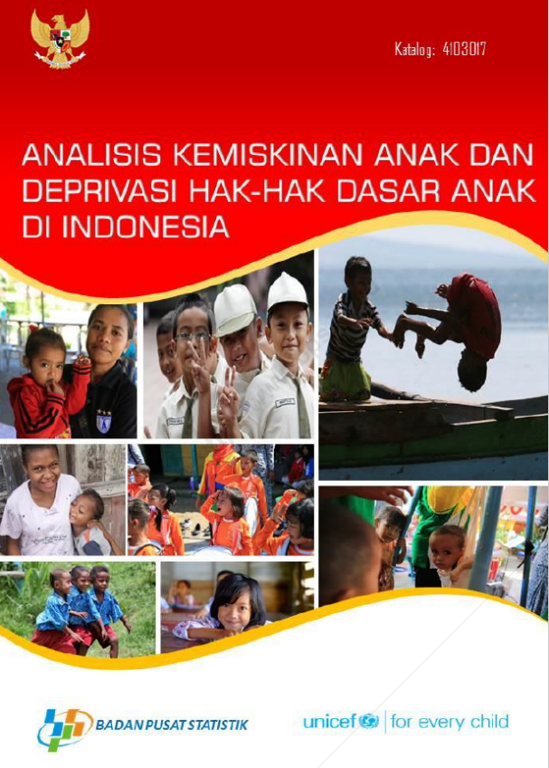
Adaptation of Multidimensional Poverty in Indonesia
BPS and Unicef published monetary and multidimensional child poverty using the child right based approach, the Multidimensional Overlapping Deprivation Analysis (MODA) in 2017.
The multidimensional poverty was calculated using Socio Economic Survey (SUSENAS) March 2016.

